Slide 1
Chapter 1: What is Computer Vision?

Slide 2
Contents
What is Computer Vision (CV)?
How CV works?
Some computer vision tasks

Slide 3
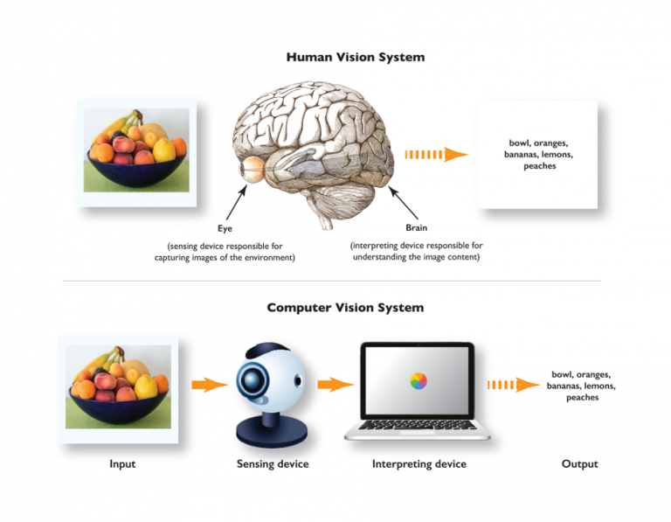
What is Computer Vision?
  “Computer vision is a field of artificial intelligence (AI) that enables computers and systems to derive meaningful information from digital images, videos and other visual inputs — and take actions or make recommendations based on that information.”
  AI -> computers think
  Computer vision-> computers see, observe and understand.

Slide 4

What is Computer Vision?
Interpreting and Analysis of the scence:
Who are in there?
What is in the image?
What is happening?

Slide 5



How computer vision works?
Acquiring an image Images, even large sets, can be acquired in real-time through video, photos or 3D technology for analysis. | Processing the image Deep learning models automate much of this process, but the models are often trained by first being fed thousands of labeled or pre-identified images. | Understanding the image The final step is the interpretative step, where an object is identified or classified.

Slide 6
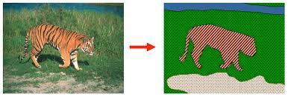
Some computer vision tasks
Image segmentation:
  partitions an image into multiple regions or pieces to be examined separately.

Slide 7
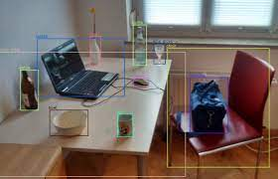
Some computer vision tasks
Object detection: identifies a specific object in an image.

Slide 8

Some computer vision tasks
Facial recognition: is an advanced type of object detection that not only recognizes a human face in an image, but identifies a specific individual.

Slide 9
Some computer vision tasks
Edge detection is a technique used to identify the outside edge of an object or landscape to better identify what is in the image.
Pattern detection is a process of recognizing repeated shapes, colors and other visual indicators in images.
Image classification groups images into different categories.
Feature matching is a type of pattern detection that matches similarities in images to help classify them.

